Slide 1
Evaluating regression Model performance
A look at the various approaches to determine model performance

Slide 2
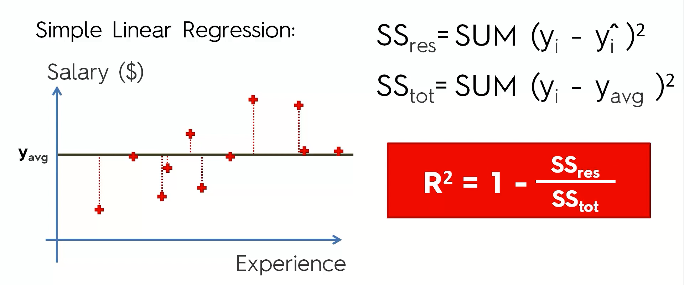
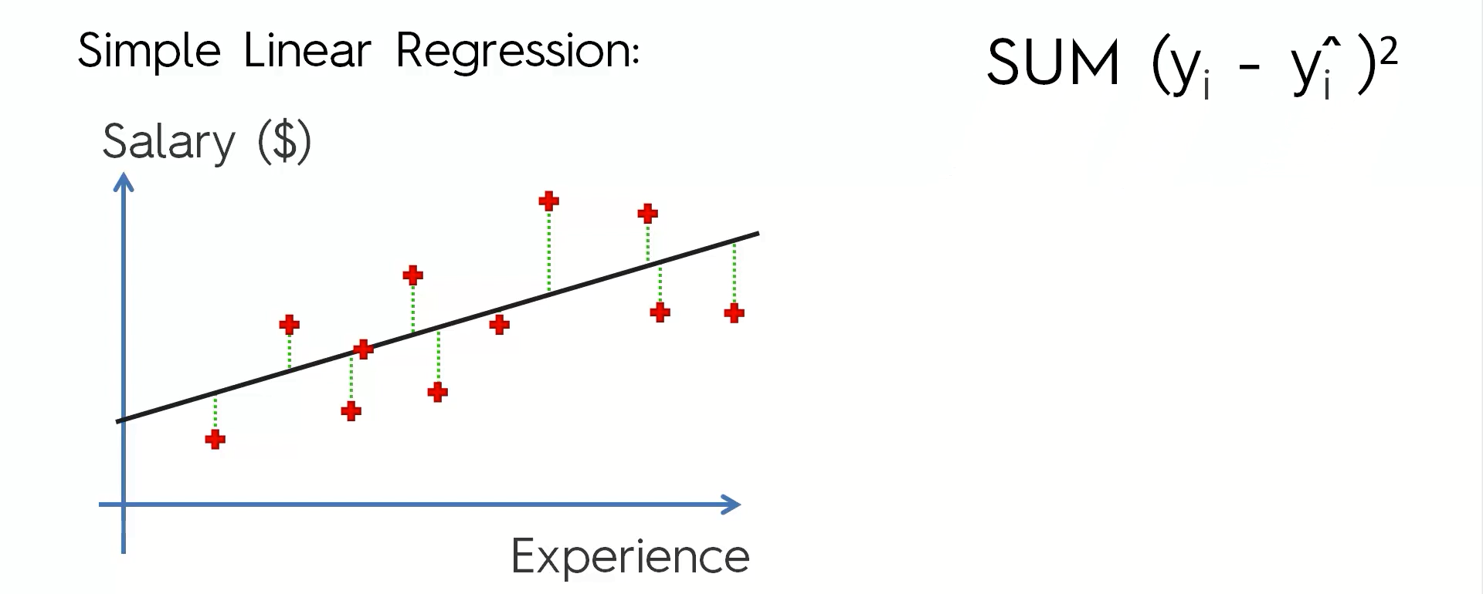
R SQUARED
The closer R² is to 1, the better our model.

Slide 3
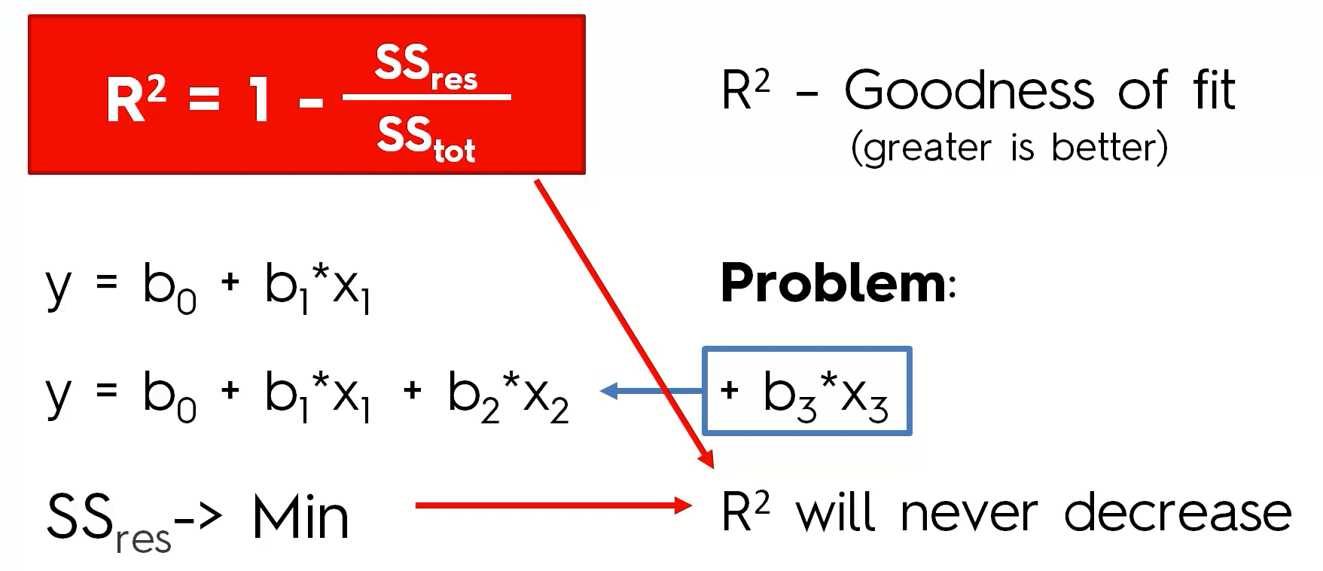
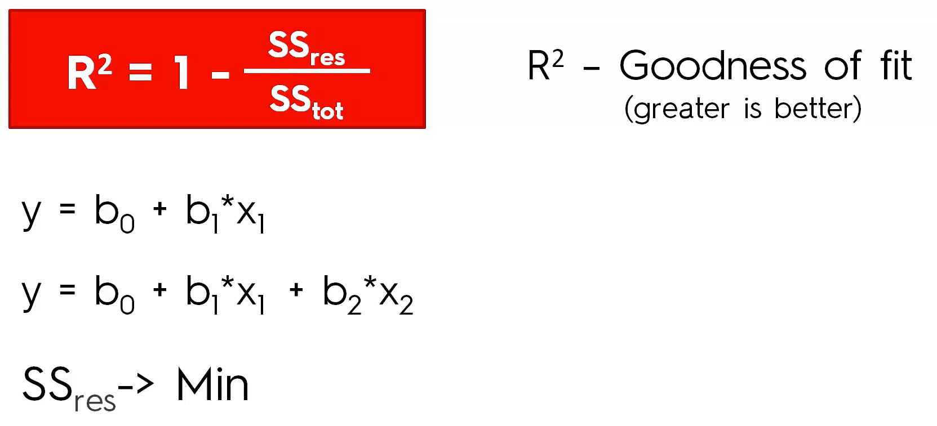
R squared value

Slide 4
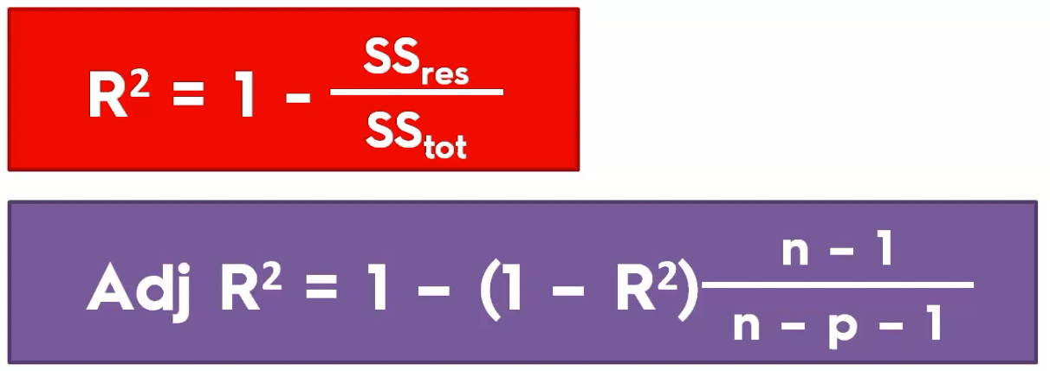

Adjusted r squared

